Slide 1

Airbnb Price Predictor
By Group 4
ABADS Batch 11

Slide 2
Project Overview:
This project aims to predict the price of Airbnb properties based on various property features using machine learning techniques.
Features: Key features include geographical data (latitude, longitude), property characteristics (accommodates, bedrooms, bathrooms), amenities (Wifi, Essentials), host information (host age), and temporal data (listing date, host since date).

Slide 3
Exploratory Data Analysis:
Objective: To analyze the attributes and find the relation of those attributes with the target variable i.e. price of the properties.

Slide 4
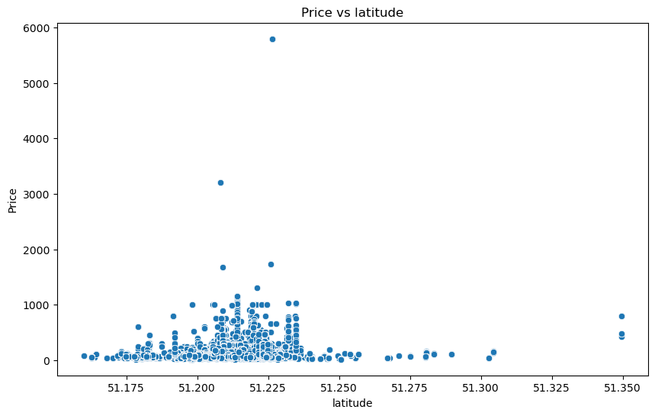
Analysis by Latitude:
Most of the Properties are located between:​
51.207870 and 51.220905 latitude. ​
Prices of the properties are high between the latitudes 51.200 and 51.250.

Slide 5
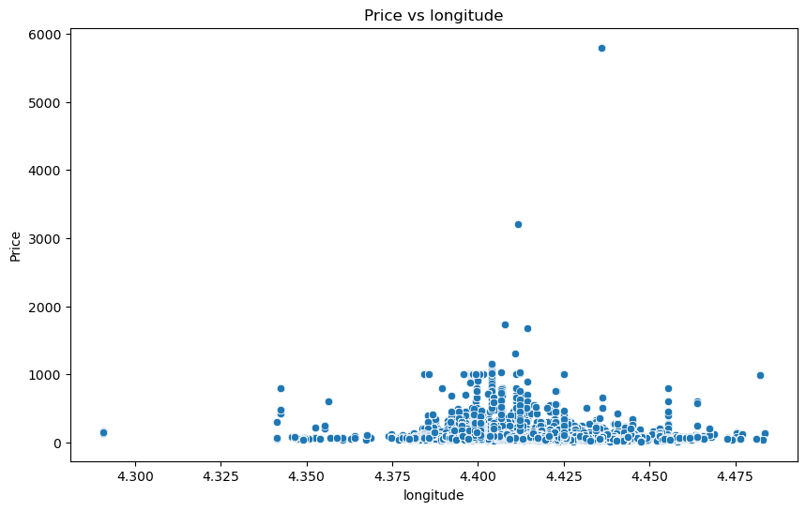
Analysis by Longitude:
Most of the Properties are located between:​
4.400140 and 4.424660 longitude.
The prices of the properties are relatively high between the longitudes: 4.400 and 4.425. ​

Slide 6
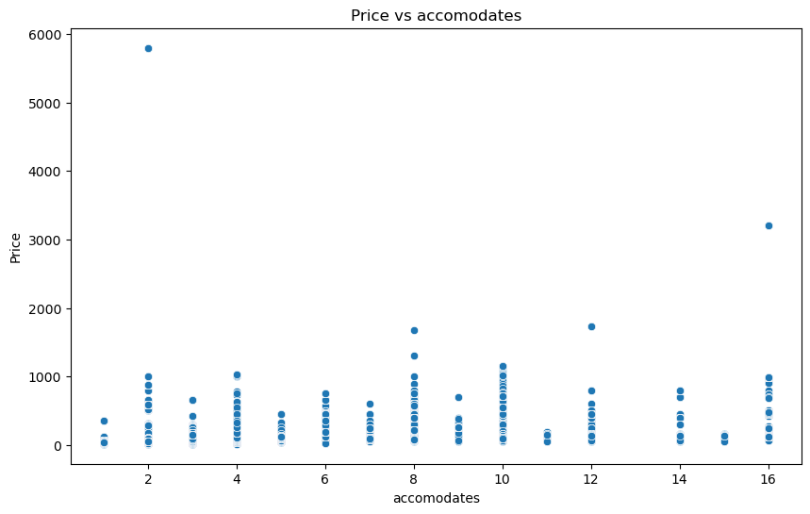
Analysis by Accommodates:
The accommodation varies from 1 to 16 depending on the property type.
The prices of the even number of accommodation are relatively higher.

Slide 7
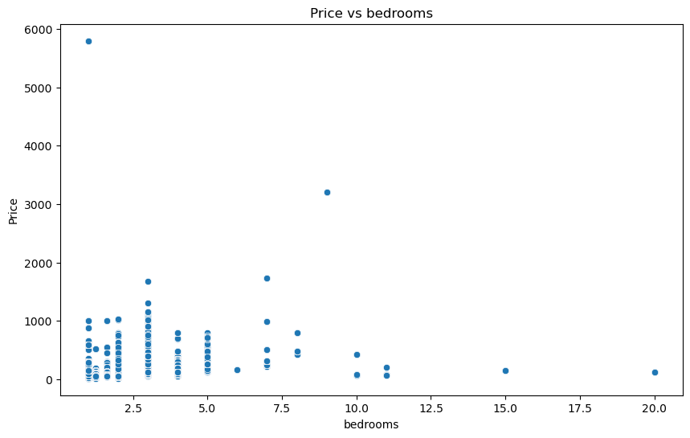
Analysis by Bedrooms:
Most of the Properties are offer 1 to 5 bedrooms according to the room type.
The highest price was for a single bedroom.

Slide 8
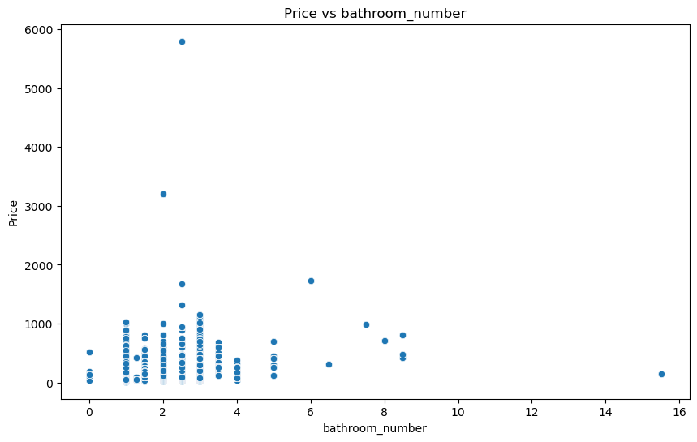
Analysis by Bathrooms:
Most of the Properties offer 1 to 5 bathrooms.
The price increases when the bathroom count reaches 3 and then decreases.

Slide 9
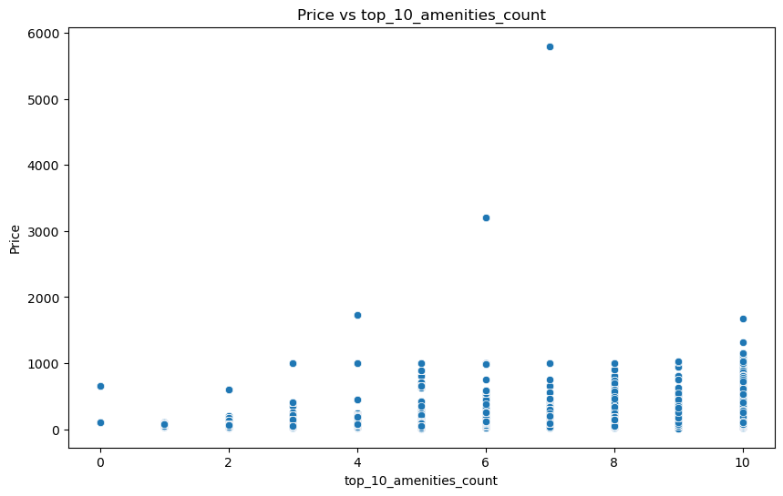
Analysis by Amenities:
The price increases when the property offers more basic amenities that are provided by all the properties.

Slide 10
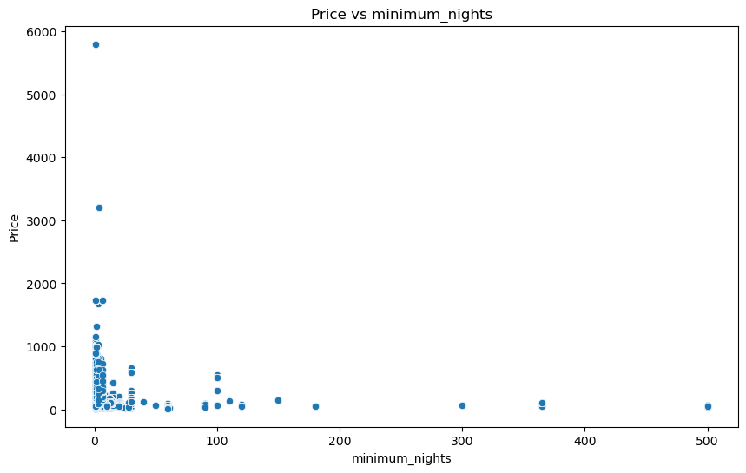
Analysis by Minimum Nights:
Most of the Properties offers minimum of 5 night's stay.

Slide 11
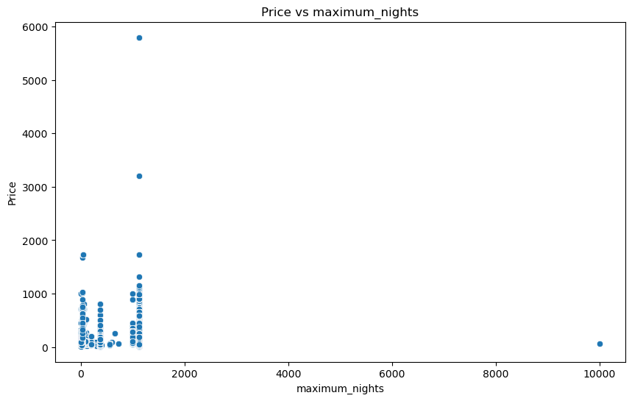
Analysis by Maximum Nights:
Most of the Properties offers maximum of 813 night's stay.

Slide 12
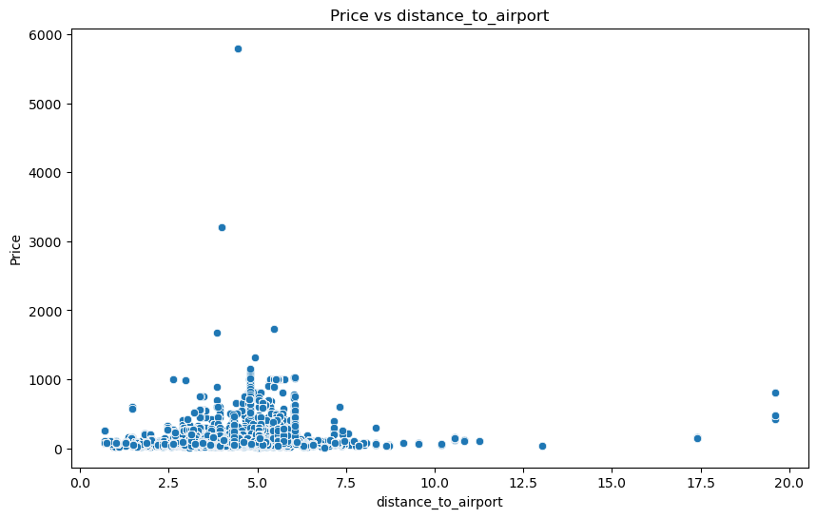
Analysis by Distance to Airport:
Most of the are located in 4.55 km distance from the airport.
The price is high when the distance is between 3 to 6 km.

Slide 13
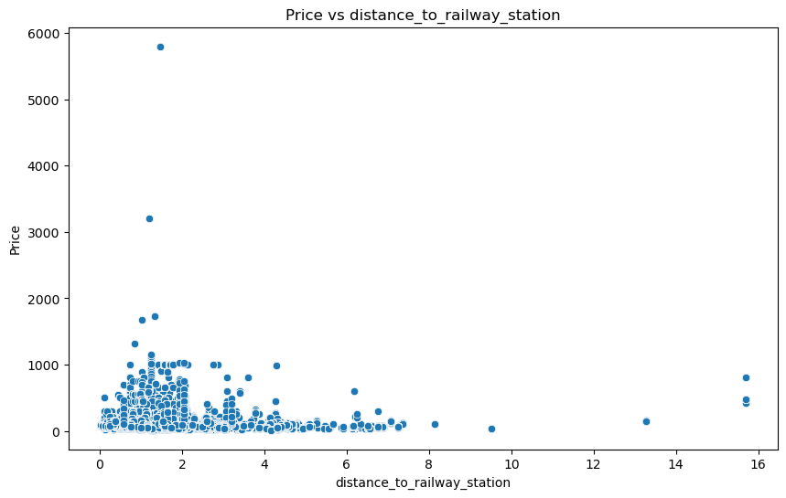
Analysis by Distance to Railway:
Most of the are located in 1.73 km distance from the railway station.
The price is high when the distance is between 0 to 2 km.

Slide 14
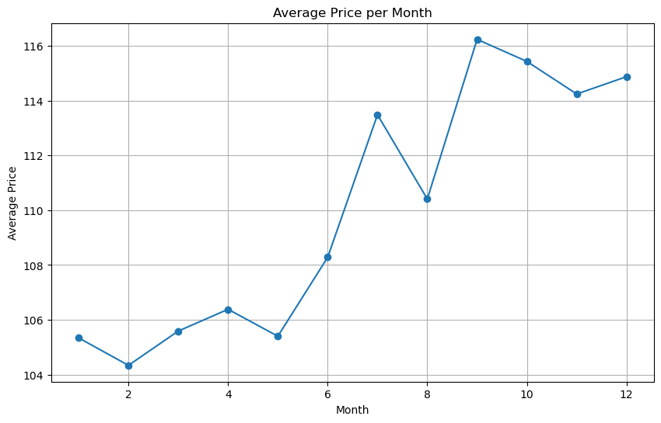
Analysis by booking month
The average price increase in the end of the year.
The highest average price can be seen in the month of September.

Slide 15
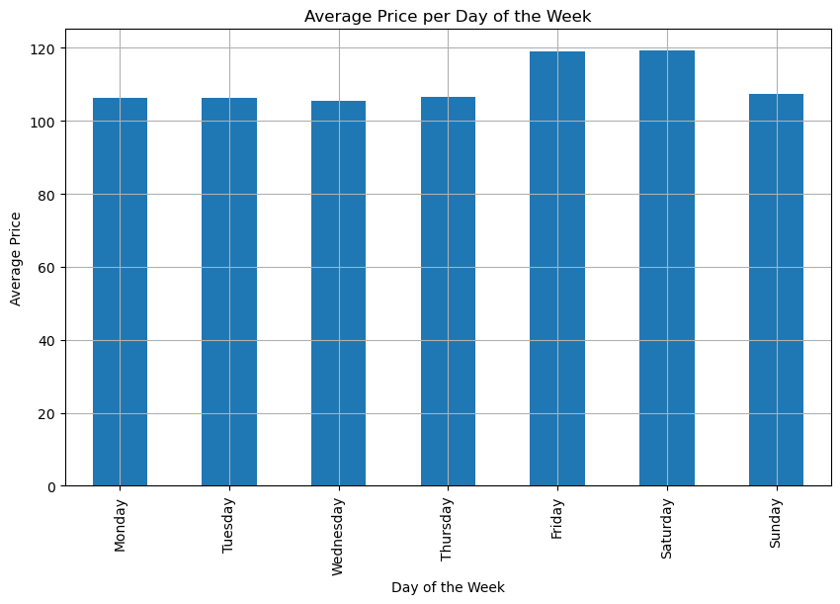
Analysis by booking day
The average price is similar on weekends and weekdays.

Slide 16
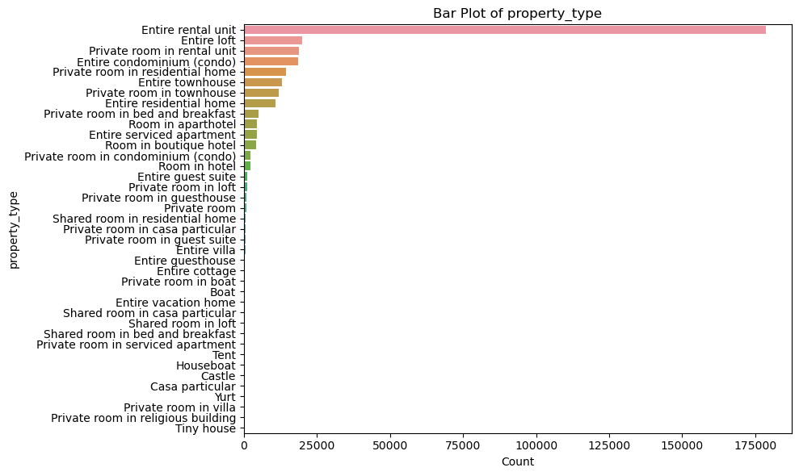
Analysis by Property Type
Most of the users prefer booking the entire rental unit followed by entire loft.

Slide 17
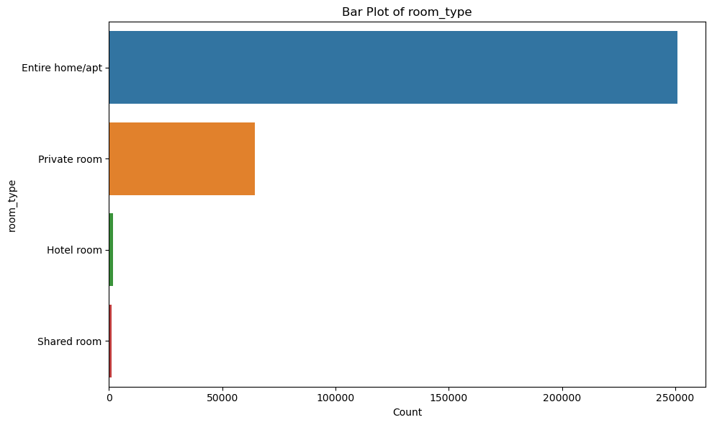
Analysis by Property Type
Most of the users prefer booking the entire home/apartment followed by private room.

Slide 18
Model Building:
Objective: To build the following models and select one of them on the basis of their performance on metrics like R², MAE and MSE:
Linear Regression
Decision Tree Regressor
Random Forest Regressor
Gradient Boosting Regressor
XGBoost Regressor
LightGBM Regressor

Slide 19
R² (Coefficient of Determination):
Definition: R² measures the proportion of the variance in the dependent variable that is predictable from the independent variables.
Range: 0 to 1 (though it can be negative for models that are worse than a horizontal line).
Interpretation: A higher R² indicates a better fit to the data. An R² of 1 means the model explains all the variability of the response data around its mean, while an R² of 0 means the model does not explain any variability.
Importance: Useful for understanding the proportion of variance explained by the model.

Slide 20
Mean Absolute Error (MAE):
Definition: MAE is the average of the absolute errors between the predicted and actual values.
Formula: MAE= n1 ∑i=1n ∣yi −y^ i ∣
Range: 0 to ∞
Interpretation: Lower values indicate better model performance. MAE is intuitive as it represents the average magnitude of errors in a set of predictions, without considering their direction.
Importance: It gives a clear understanding of the average error in the same units as the target variable, making it easy to interpret.

Slide 21
Mean Squared Error (MSE):
Definition: MSE is the average of the squared errors between the predicted and actual values.
Formula: MSE= n1 ∑i=1n (yi −y^ i )2
Range: 0 to ∞
Interpretation: Lower values indicate better model performance. MSE gives more weight to larger errors because the errors are squared before they are averaged, making it useful for highlighting large errors.
Importance: Helps in identifying models that perform well on all predictions, as it penalizes larger errors more severely.

Slide 22
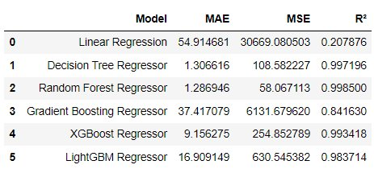
Model Train Values:
After reviewing all the metrics we can observer that the Random forest Regressor has performed better than other algorithms,

Slide 23
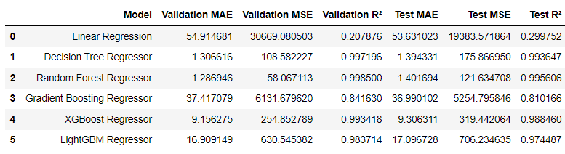
Model Test Values:
After reviewing all the metrics we can observer that the Random forest Regressor has performed better than other algorithms,

Slide 24
Model Selection:
Model Finalized: Random Forest Regressor
Reason for Finalization: The Random Forest Regressor had the lowest MAE and MSE, and the highest R² score among all models tested, indicating superior performance in predicting the target variable.

Slide 25
Top 5 Important features:
Features | Importance
property_type_Private room in townhouse | 0.2748234452248065
property_type_Entire villa | 0.1395171098846886
accomodates | 0.0676499818152491
bathroom_number | 0.0661802554689856
distance_to_railway_station | 0.0543257803967892
latitude | 0.04780362196350711
distance_to_airport | 0.041819632976037004

Slide 26
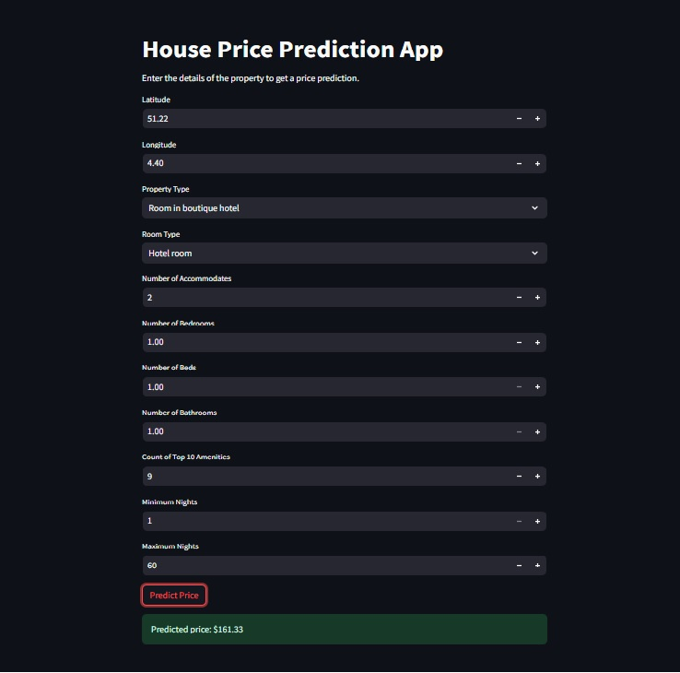
Model Deployment
Deployed our project using the stream lit and spyder.
Validated the model using the sample data from the dataset.

Slide 27
Thank You

